Slide 1


EEE 304 - Digital Electronics Laboratory
Jan 2024 Level-3 Term-2 Section-B2
Final Project Demonstration
DESIGN AND IMPLEMENTATION OF FPGA BASED
VENDING MACHINE USING VERILOG
SUBMITTED BY: GROUP 8
PRESENTED TO:
Nafis Sadik, Lecturer,Dept of EEE,BUET
Rafichha Yasmin, PT,Dept of EEE,BUET
BANGLADESH UNIVERSITY OF ENGINEERING AND TECHNOLOGY
DEPARTMENT OF ELECTRICAL AND ELECTRONIC ENGINEERING

Slide 2
OUTLINE
SUMMARY
INTRODUCTION
TYPES OF FSM
DESIGN
IMPLEMENTATION
ANALYSIS AND EVALUATION
WORK DISTRIBUTION
LIMITATIONS
OBE OUTCOMES
REFERENCES
DEMONSTRATION
EEE 304 (2024) - Final Project Group 8
DESIGN AND IMPLEMENTATION OF FPGA BASED VENDING MACHINE
PRESENTED BY: 2006109

Slide 3

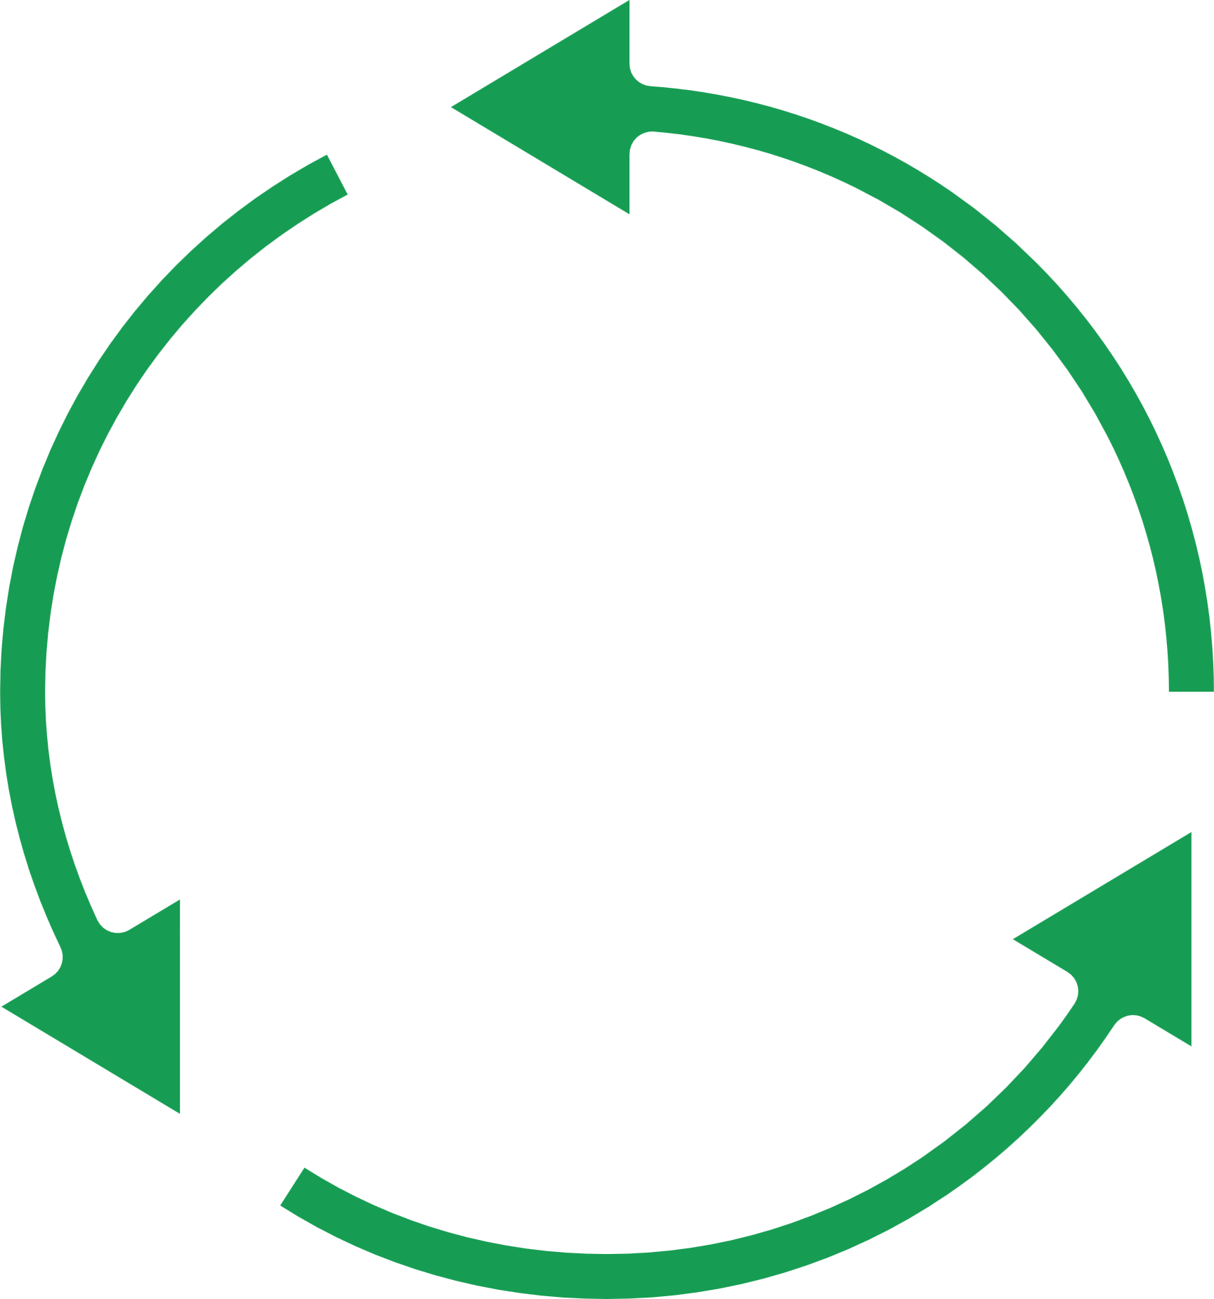
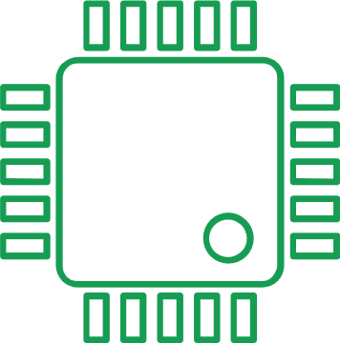

SUMMARY
This project aims to develop a smart and interactive vending machine system. This system uses a finite-state machine (FSM) on a field-programmable gate array (FPGA). The FSM manages the vending machine's functions, such as accepting coins, dispensing products, and giving user feedback.
User-friendly
FSM (Finite-State Machine)
FPGA
Feedback
EEE 304 (2024) - Final Project Group 8
DESIGN AND IMPLEMENTATION OF FPGA BASED VENDING MACHINE
PRESENTED BY: 2006109

Slide 4
LITERATURE REVIEW
To design the vending machines using FSM, several studies have been conducted. Some notable ones are:
Design and implementation of vending machine using Verilog. [3]
Implementation of FPGA-based smart vending machine. [4]
Limitations of Previous works
Accepts coins of denominations 5 and 10TK only (Limited)
No mechanism for incrementally adding more cash.
EEE 304 (2024) - Final Project Group 8
DESIGN AND IMPLEMENTATION OF FPGA BASED VENDING MACHINE
PRESENTED BY: 2006109

Slide 5
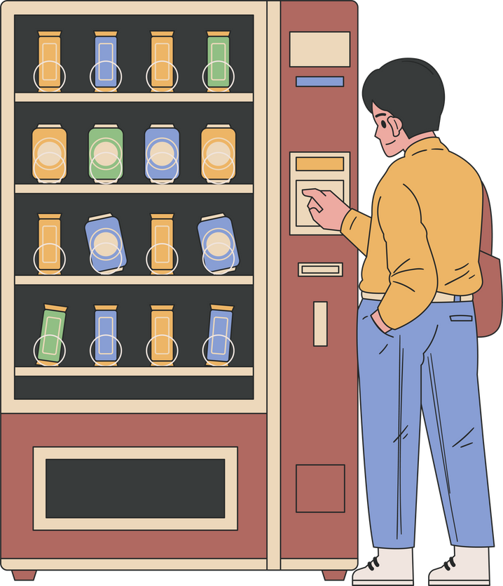


INTRODUCTION
A vending machine is a self-service device that dispenses products like snacks & drinks to customers after they make a payment. The vending machine typically accepts coins, handles product selection, and dispenses the selected product if sufficient funds have been deposited.
Select item
Insert coin
Product purchased
EEE 304 (2024) - Final Project Group 8
DESIGN AND IMPLEMENTATION OF FPGA BASED VENDING MACHINE
PRESENTED BY: 2006109

Slide 6
INTRODUCTION
A Finite State Machine (FSM) is a sequential circuit that operates with a fixed (finite) number of states. At any given moment, the machine resides in one specific state. The machine transitions from one state to another based on input signals; this process is referred to as a transition, and the total number of states is known as the modulus.
An FSM is composed of a state register and combinational logic.
A State Diagram is a directed graph where the nodes depict the internal states, and the arrows represent the transitions between these states.
EEE 304 (2024) - Final Project Group 8
DESIGN AND IMPLEMENTATION OF FPGA BASED VENDING MACHINE
PRESENTED BY: 2006109

Slide 7
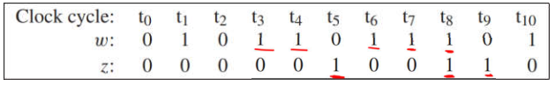

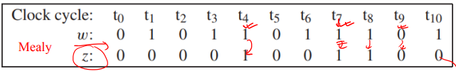
TYPES OF FSM
MOORE
outputs depend only on current state
MEALY
outputs depend on current state and inputs
EEE 304 (2024) - Final Project Group 8
DESIGN AND IMPLEMENTATION OF FPGA BASED VENDING MACHINE
PRESENTED BY: 2006109

Slide 8
MEALY TYPE FSM
SYNCHRONOUS
SEQUENTIAL CIRCUIT
Flip-flops
Combinational Circuit
Combinational Circuit
W
Q
Clock
EEE 304 (2024) - Final Project Group 8
DESIGN AND IMPLEMENTATION OF FPGA BASED VENDING MACHINE
PRESENTED BY: 2006109

Slide 9
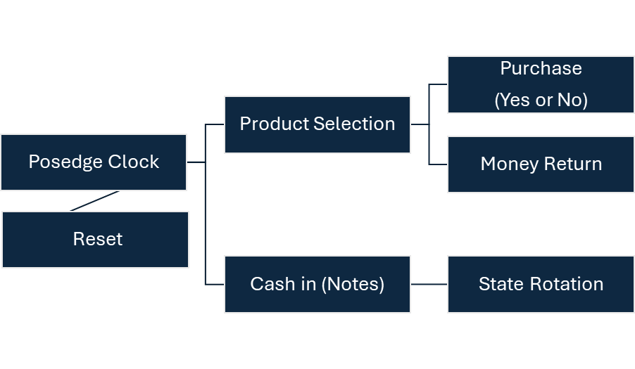
VERILOG CODE
EEE 304 (2024) - Final Project Group 8
DESIGN AND IMPLEMENTATION OF FPGA BASED VENDING MACHINE
PRESENTED BY: 2006109

Slide 10
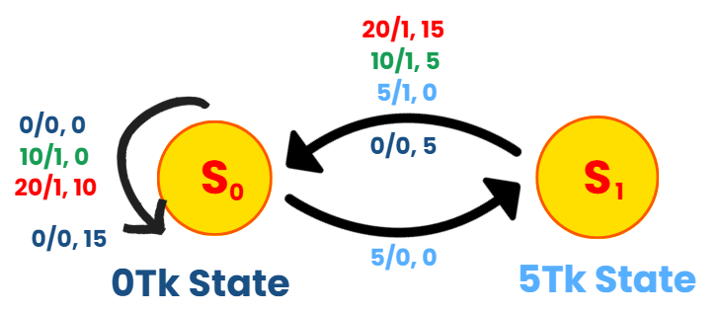
STATE DIAGRAM
PRODUCT: 10Tk
Notation
Money/Purchase, Change
S
0
0Tk State or 10Tk State
S
1
5Tk State
EEE 304 (2024) - Final Project Group 8
DESIGN AND IMPLEMENTATION OF FPGA BASED VENDING MACHINE
PRESENTED BY: 2006109

Slide 11
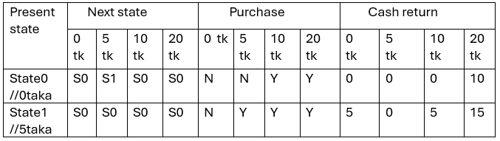
STATE TABLE
PRODUCT: 10Tk
EEE 304 (2024) - Final Project Group 8
DESIGN AND IMPLEMENTATION OF FPGA BASED VENDING MACHINE
PRESENTED BY: 2006109

Slide 12
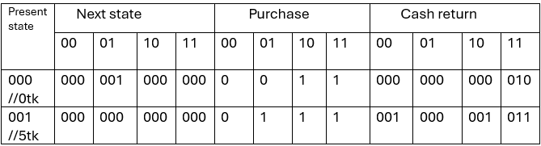
STATE ASSIGNED TABLE
PRODUCT: 10Tk
EEE 304 (2024) - Final Project Group 8
DESIGN AND IMPLEMENTATION OF FPGA BASED VENDING MACHINE
PRESENTED BY: 2006109

Slide 13
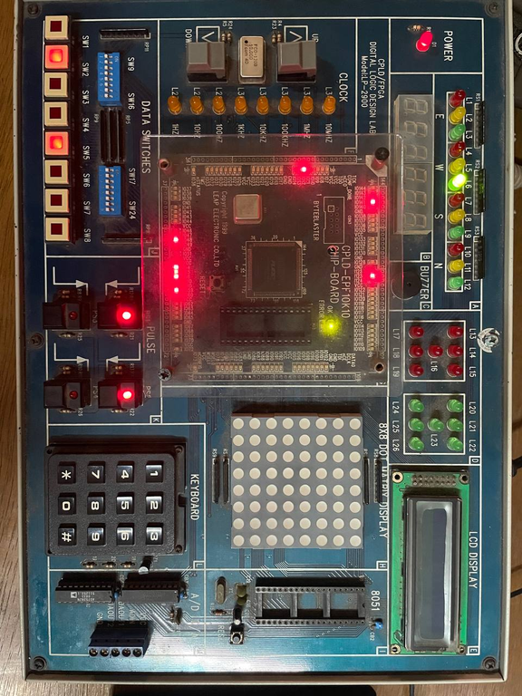
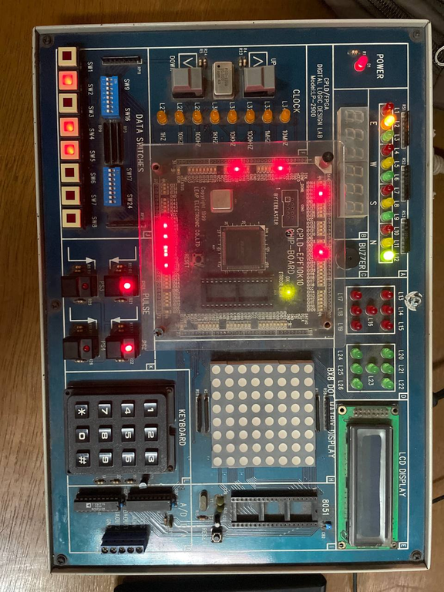
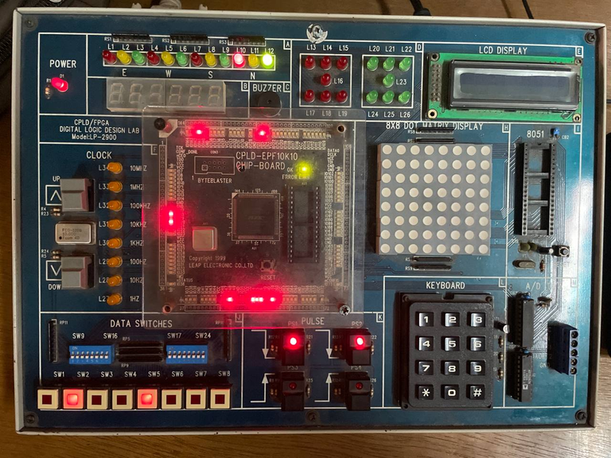
TEST CASE
PRODUCT: 10Tk
CASH IN = 5Tk (01)
CHANGE= 0Tk (000)
PURCHASE = 0 (LED OFF)
CASH IN = 5Tk more (01)
CHANGE= 0Tk (000)
PURCHASE = 1 (LED ON)
CASH IN = 20Tk (11)
CHANGE= 10Tk (010)
PURCHASE = 1 (LED ON)
EEE 304 (2024) - Final Project Group 8
DESIGN AND IMPLEMENTATION OF FPGA BASED VENDING MACHINE
PRESENTED BY: 2006109

Slide 14
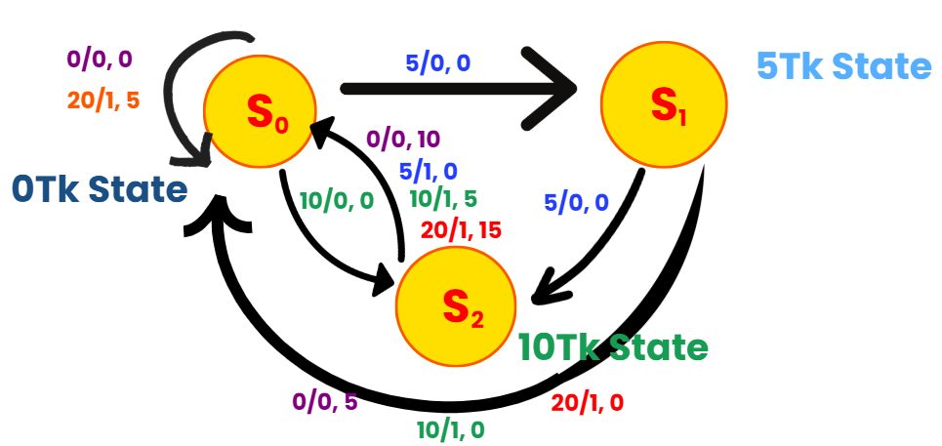
STATE DIAGRAM
PRODUCT: 15Tk
Notation
Money/Purchase, Change
S
0
0Tk State or 15Tk State
S
1
5Tk State
S
2
10Tk State
EEE 304 (2024) - Final Project Group 8
DESIGN AND IMPLEMENTATION OF FPGA BASED VENDING MACHINE
PRESENTED BY: 2006109

Slide 15
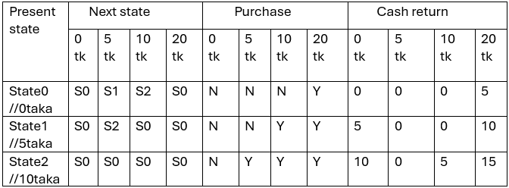
STATE TABLE
PRODUCT: 15Tk
EEE 304 (2024) - Final Project Group 8
DESIGN AND IMPLEMENTATION OF FPGA BASED VENDING MACHINE
PRESENTED BY: 2006109

Slide 16
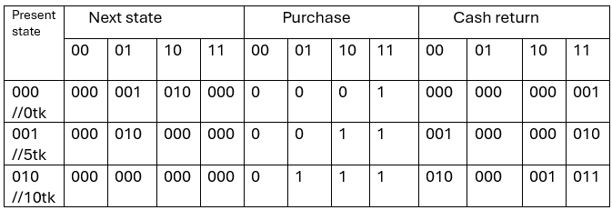
STATE ASSIGNED TABLE
PRODUCT: 15Tk
EEE 304 (2024) - Final Project Group 8
DESIGN AND IMPLEMENTATION OF FPGA BASED VENDING MACHINE
PRESENTED BY: 2006109

Slide 17
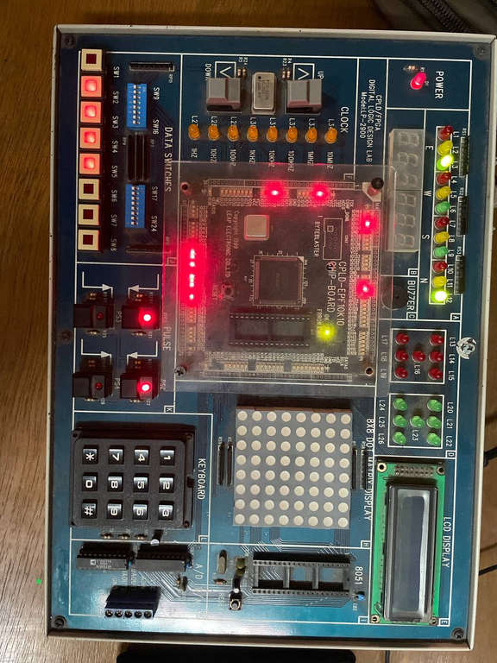
TEST CASE
PRODUCT: 15Tk
CASH IN = 20Tk (11)
CHANGE= 5Tk (001)
PURCHASE = 1 (LED ON)
EEE 304 (2024) - Final Project Group 8
DESIGN AND IMPLEMENTATION OF FPGA BASED VENDING MACHINE
PRESENTED BY: 2006109

Slide 18
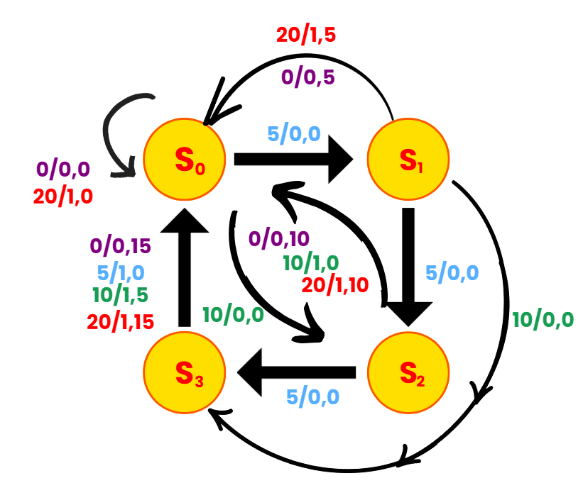
STATE DIAGRAM
PRODUCT: 20Tk
Notation
Money/Purchase, Change
S
0
0Tk State or 20Tk State
S
1
5Tk State
S
2
10Tk State
S
3
15Tk State
EEE 304 (2024) - Final Project Group 8
DESIGN AND IMPLEMENTATION OF FPGA BASED VENDING MACHINE
PRESENTED BY: 2006109

Slide 19
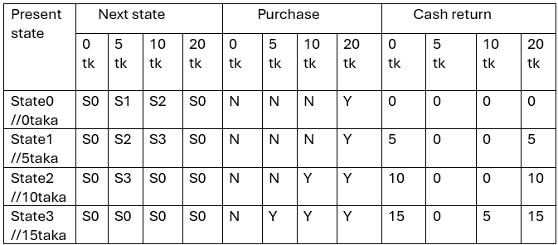
STATE TABLE
PRODUCT: 20Tk
EEE 304 (2024) - Final Project Group 8
DESIGN AND IMPLEMENTATION OF FPGA BASED VENDING MACHINE
PRESENTED BY: 2006109

Slide 20
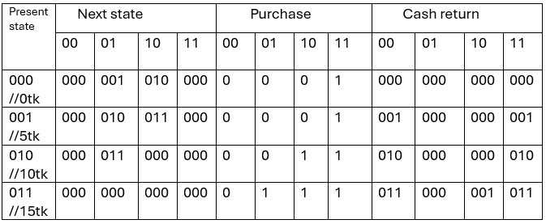
STATE ASSIGNED TABLE
PRODUCT: 20Tk
EEE 304 (2024) - Final Project Group 8
DESIGN AND IMPLEMENTATION OF FPGA BASED VENDING MACHINE
PRESENTED BY: 2006109

Slide 21
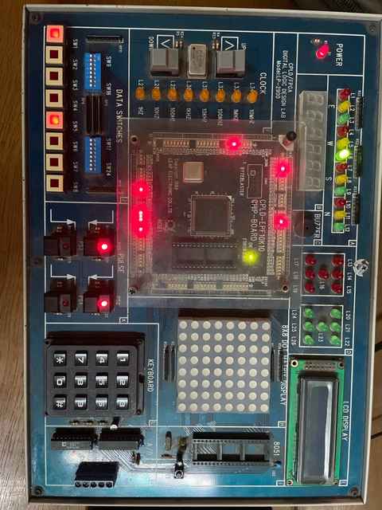
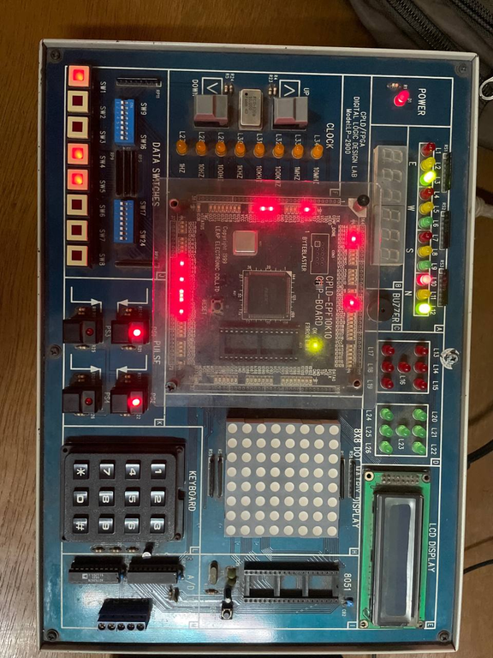
TEST CASE
PRODUCT: 20Tk
CASH IN = 5Tk (01)
CHANGE= 0Tk (000)
PURCHASE = 0 (LED OFF)
CASH IN = 20Tk more (11)
CHANGE= 5Tk (001)
PURCHASE = 1 (LED ON)
EEE 304 (2024) - Final Project Group 8
DESIGN AND IMPLEMENTATION OF FPGA BASED VENDING MACHINE
PRESENTED BY: 2006109

Slide 22
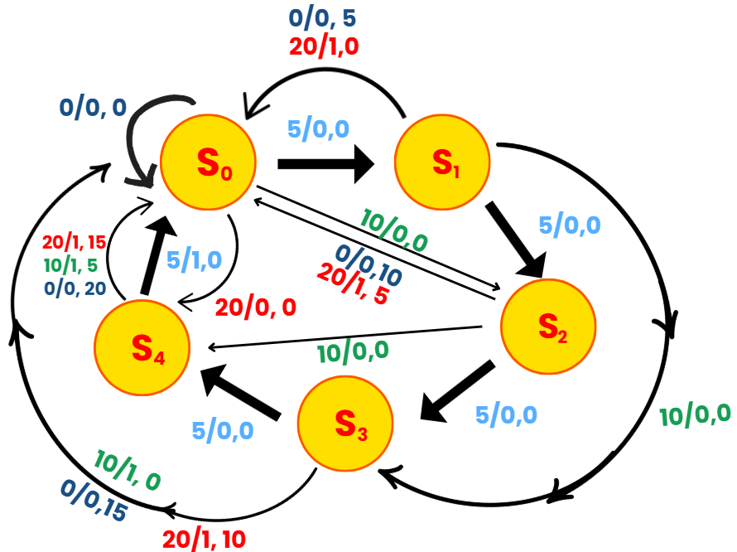
STATE DIAGRAM
PRODUCT: 25Tk
Notation
Money/Purchase, Change
S
0
0Tk State or 25Tk State
S
1
5Tk State
S
2
10Tk State
S
3
15Tk State
S
4
20Tk State
EEE 304 (2024) - Final Project Group 8
DESIGN AND IMPLEMENTATION OF FPGA BASED VENDING MACHINE
PRESENTED BY: 2006109

Slide 23
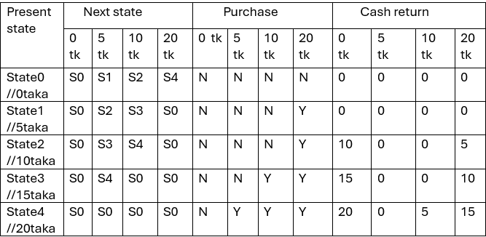
STATE TABLE
PRODUCT: 25Tk
EEE 304 (2024) - Final Project Group 8
DESIGN AND IMPLEMENTATION OF FPGA BASED VENDING MACHINE
PRESENTED BY: 2006109

Slide 24
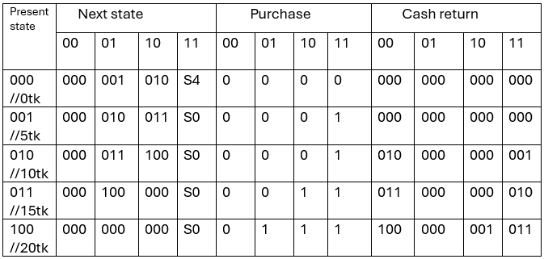
STATE ASSIGNED TABLE
PRODUCT: 25Tk
EEE 304 (2024) - Final Project Group 8
DESIGN AND IMPLEMENTATION OF FPGA BASED VENDING MACHINE
PRESENTED BY: 2006109

Slide 25
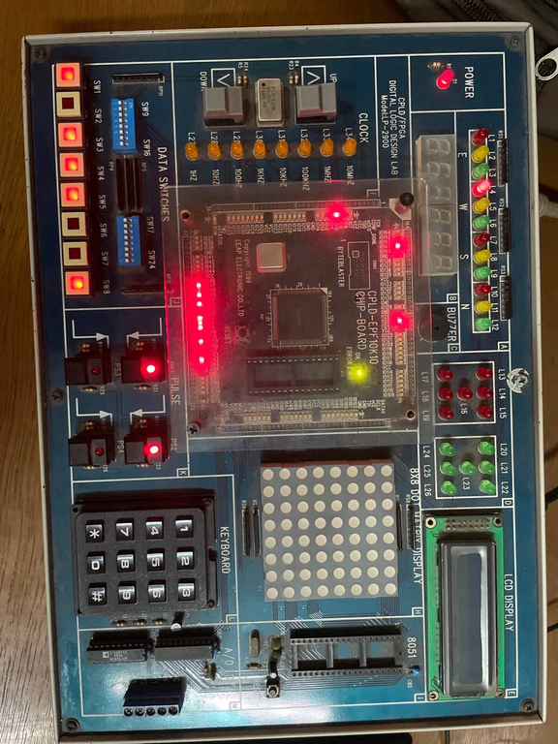
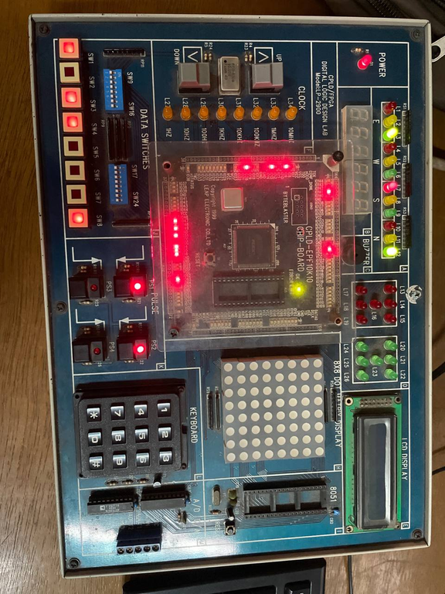
TEST CASE
PRODUCT: 25Tk
CASH IN = 20Tk (11)
CHANGE= 0Tk (000)
PURCHASE = 0 (LED OFF)
CASH IN = 10Tk more (10)
CHANGE= 5Tk (001)
PURCHASE = 1 (LED ON)
EEE 304 (2024) - Final Project Group 8
DESIGN AND IMPLEMENTATION OF FPGA BASED VENDING MACHINE
PRESENTED BY: 2006109

Slide 26
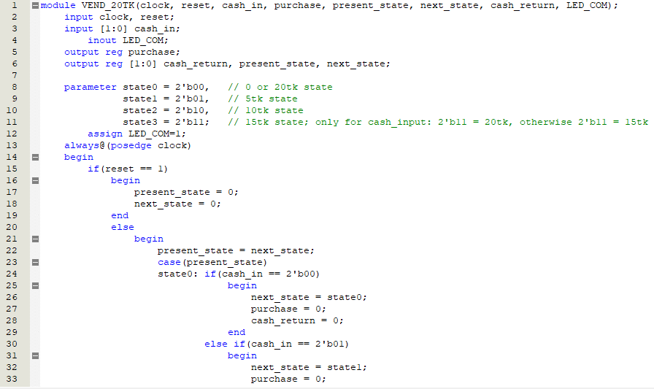
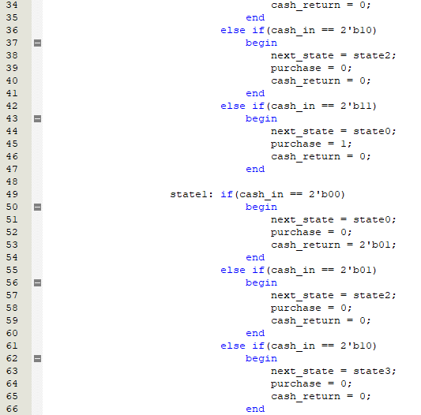
VERILOG CODE
PRODUCT: 20Tk
EEE 304 (2024) - Final Project Group 8
DESIGN AND IMPLEMENTATION OF FPGA BASED VENDING MACHINE
PRESENTED BY: 2006109

Slide 27
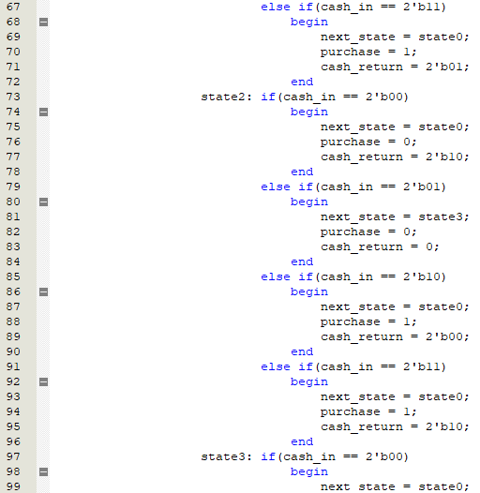
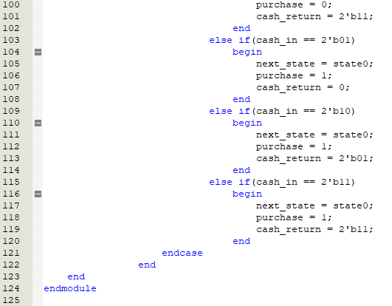
VERILOG CODE
PRODUCT: 20Tk
EEE 304 (2024) - Final Project Group 8
DESIGN AND IMPLEMENTATION OF FPGA BASED VENDING MACHINE
PRESENTED BY: 2006109

Slide 28
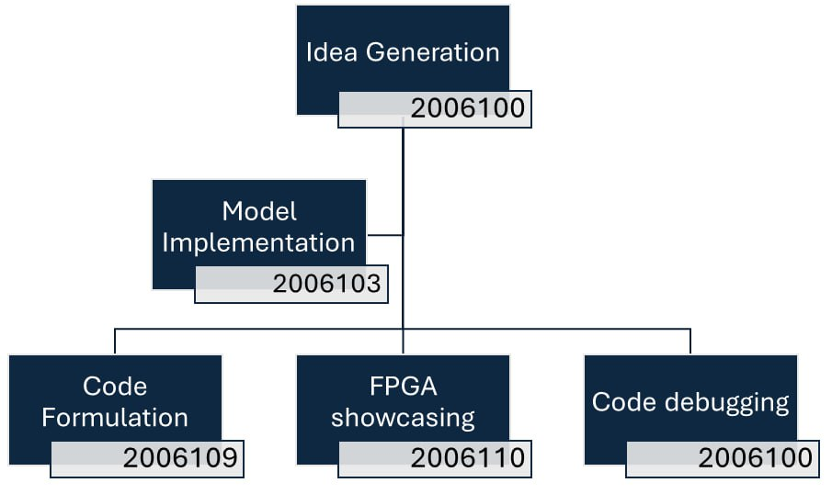
WORK DISTRIBUTION
EEE 304 (2024) - Final Project Group 8
DESIGN AND IMPLEMENTATION OF FPGA BASED VENDING MACHINE
PRESENTED BY: 2006109

Slide 29
LIMITATIONS
Reset : In our vending machine, if the reset button is pressed at any point during operation, the machine will reset and display the cash-in value as 0, regardless of any cash that has already been inserted. It does not return the previously inserted cash if the reset button is pressed.
Amount of money: The vending machine only accepts cash denominations of 5 TK, 10 TK, and 20 TK, limiting its flexibility to handle other amounts. Another drawback is
Acceptance: the lack of a display to indicate the cash inserted and the cash returned (in TK), which reduces the user-friendliness of the vending machine.
EEE 304 (2024) - Final Project Group 8
DESIGN AND IMPLEMENTATION OF FPGA BASED VENDING MACHINE
PRESENTED BY: 2006109

Slide 30
OBE OUTCOMES
CO3: Design a digital system to solve a relevant problem with due considerations to social, cultural, and environmental concerns (PO(c))
CO5: work effectively as an individual and as a team member towards the successful completion of the project
(PO(i))
EEE 304 (2024) - Final Project Group 8
DESIGN AND IMPLEMENTATION OF FPGA BASED VENDING MACHINE
PRESENTED BY: 2006109

Slide 31
REFERENCES
M. Morris Mano “Digital logic and computer design” 3rd edition pearson.
Stephen Brown and Zvonko Vranesic “Fundamentals of Digital Logic with Verilog Design” 3rd edition.
Muhammad Ali Qureshi “Design and implementation of vending machine using Verilog” 2nd international conference on networking and information technology. IPCSIT vol.17, pp-6 (2011).
B. jyothi, Isarah, A.srinivas “Implementation of FPGA based smart vending machine ” international journal of engineering research and application (IJERA) 2248-9622. National conference on development advances and trend in engineering science (NCDATES 09th and 10th January 2015
EEE 304 (2024) - Final Project Group 8
DESIGN AND IMPLEMENTATION OF FPGA BASED VENDING MACHINE
PRESENTED BY: 2006109

Slide 32
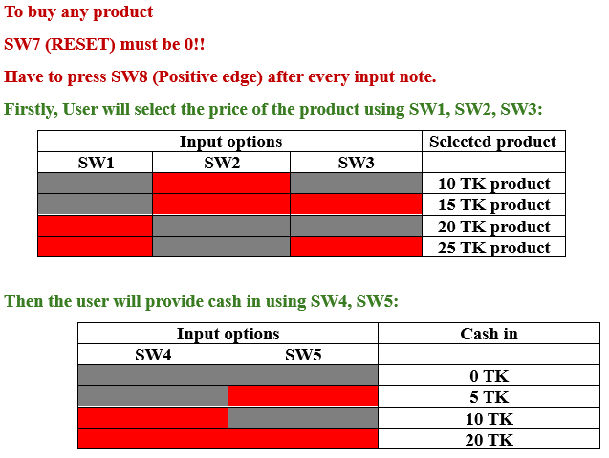
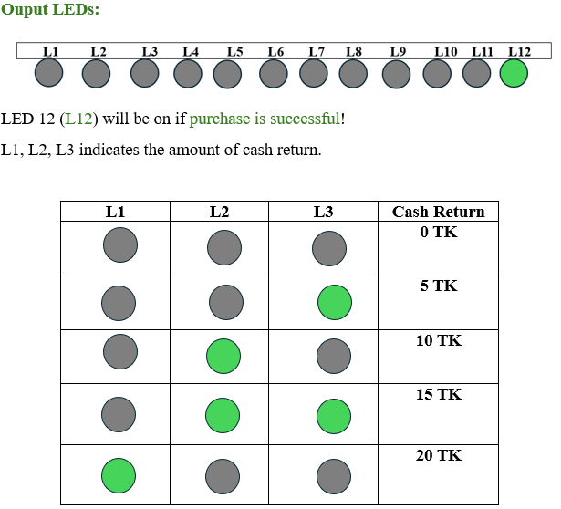
USER MANUAL
EEE 304 (2024) - Final Project Group 8
DESIGN AND IMPLEMENTATION OF FPGA BASED VENDING MACHINE
PRESENTED BY: 2006109

Slide 33




GROUP 8
Nilanjana Majumder
Medha
Shanta
Sarker
Sheikh Munkasir
Ahmed Rafeed
Arpon Kumar
Chanda
2006100
2006103
2006109
2006110
EEE 304 (2024) - Final Project Group 8
DESIGN AND IMPLEMENTATION OF FPGA BASED VENDING MACHINE
PRESENTED BY: 2006109

